Slide 1
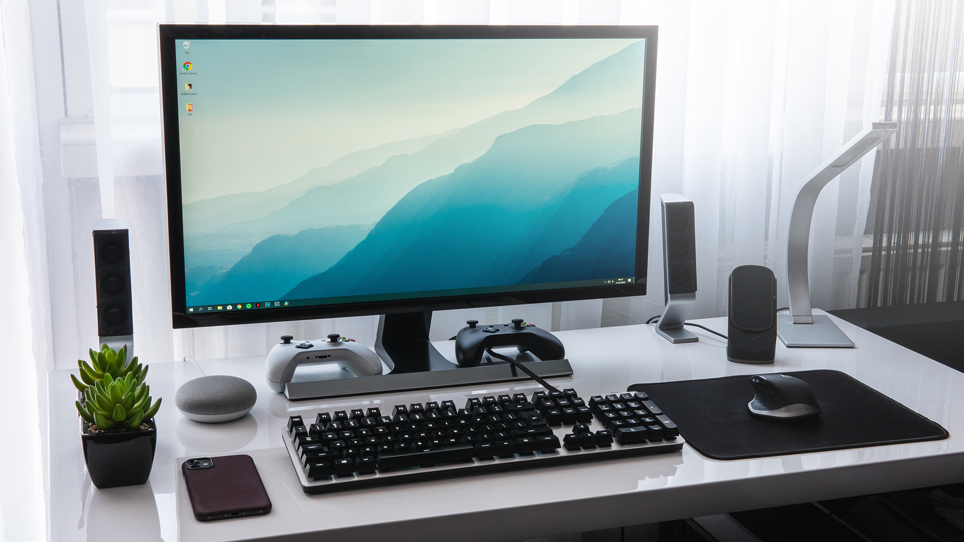
COMPUTER
A computer is a machine that can be programmed to automatically carry out sequences of arithmetic or logical operations (computation). Modern digital electronic computers can perform generic sets of operations known as programs. These programs enable computers to perform a wide range of tasks. The term computer system may refer to a nominally complete computer that includes the hardware, operating system, software, and peripheral equipment needed and used for full operation; or to a group of computers that are linked and function together, such as a computer network or computer cluster. A broad range of industrial and consumer products use computers as control systems, including simple special-purpose devices like microwave ovens and remote controls, and factory devices like industrial robots. Computers are at the core of general-purpose devices such as personal computers and mobile devices such as smartphones. Computers power the Internet, which links billions of computers and users.

Slide 2
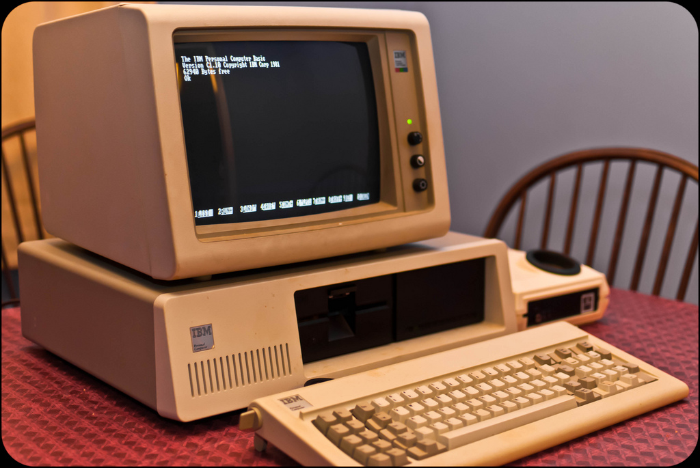
HISTORY OF COMPUTERS
Devices have been used to aid computation for thousands of years, mostly using one-to-one correspondence with fingers. The earliest counting device was most likely a form of tally stick. Later record keeping aids throughout the Fertile Crescent included calculi (clay spheres, cones, etc.) which represented counts of items, likely livestock or grains, sealed in hollow unbaked clay containers. The use of counting rods is one example. The abacus was initially used for arithmetic tasks. The Roman abacus was developed from devices used in Babylonia as early as 2400 BCE. Since then, many other forms of reckoning boards or tables have been invented. In a medieval European counting house, a checkered cloth would be placed on a table, and markers moved around on it according to certain rules, as an aid to calculating sums of money. Charles Babbage, an English mechanical engineer and polymath, originated the concept of a programmable computer. Considered the "father of the computer", he conceptualized and invented the first mechanical computer in the early 19th century.
After working on his difference engine he announced his invention in 1822, in a paper to the Royal Astronomical Society, titled "Note on the application of machinery to the computation of astronomical and mathematical tables", he also designed to aid in navigational calculations, in 1833 he realized that a much more general design, an analytical engine, was possible. The input of programs and data was to be provided to the machine via punched cards, a method being used at the time to direct mechanical looms such as the Jacquard loom. For output, the machine would have a printer, a curve plotter and a bell. The machine would also be able to punch numbers onto cards to be read in later. The Engine incorporated an arithmetic logic unit, control flow in the form of conditional branching and loops, and integrated memory, making it the first design for a general-purpose computer that could be described in modern terms as Turing-complete.

Slide 3
TYPES OF COMPUTERS
Computers can be classified in a number of different ways, including:
By architecture
Analog computer
Digital computer
Hybrid computer
Harvard architecture
Von Neumann architecture
Complex instruction set computer
Reduced instruction set computer
See also: List of computer size categories
Supercomputer
Mainframe computer
Minicomputer

Slide 4
HISTORY OF COMPUTER HARDWARE
First generation(mechanical/electromechanical)
Second generation(vacuum tubes)
Third generation(discrete transistors and SSI, MSI, LSI integrated circuits)
Fourth generation(VLSI integrated circuits)

Slide 5
First generation(mechanical/electromechanical)
Calculators | Pascal's calculator, Arithmometer, Difference engine, Quevedo's analytical machines
Programmable devices | Jacquard loom, Analytical engine, IBM ASCC/Harvard Mark I, Harvard Mark II, IBM SSEC, Z1, Z2, Z3
Second generation(vacuum tubes)
Calculators | Atanasoff–Berry Computer, IBM 604, UNIVAC 60, UNIVAC 120
Programmable devices | Colossus, ENIAC, Manchester Baby, EDSAC, Manchester Mark 1, Ferranti Pegasus, Ferranti Mercury, CSIRAC, EDVAC, UNIVAC I, IBM 701, IBM 702, IBM 650, Z22

Slide 6
Third generation(discrete transistors and SSI, MSI, LSI integrated circuits)
Mainframes | IBM 7090, IBM 7080, IBM System/360, BUNCH
Minicomputer | HP 2116A, IBM System/32, IBM System/36, LINC, PDP-8, PDP-11
Desktop Computer | HP 9100
Fourth generation(VLSI integrated circuits)
Minicomputer | VAX, IBM AS/400
4-bit microcomputer | Intel 4004, Intel 4040
8-bit microcomputer | Intel 8008, Intel 8080, Motorola 6800, Motorola 6809, MOS Technology 6502, Zilog Z80
16-bit microcomputer | Intel 8088, Zilog Z8000, WDC 65816/65802
32-bit microcomputer | Intel 80386, Pentium, Motorola 68000, ARM
64-bit microcomputer | Alpha, MIPS, PA-RISC, PowerPC, SPARC, x86-64, ARMv8-A
Embedded computer | Intel 8048, Intel 8051
Personal computer | Desktop computer, Home computer, Laptop computer, Personal digital assistant (PDA), Portable computer, Tablet PC, Wearable computer

